Slide 1


FALAHAAR: ONLINE FRUIT SHOP
PRESENTED BY
PRATIKSHA DESHMUKH(233068)
SHIVANEE MANDE(233089)

Slide 2
CONTENTS
INTRODUCTION
ABSTRACT
EXISTING AND PROPOSED SYSTEM
SOFTWARE EXPLORES
- Software Requirements
- Hardware Requirements
Diagrams
Tables
Screenshots of Output
Advantages & Disadvantages
Future scope
Conclusion

Slide 3
MODULES
- User : Admin , Customer
- Product
- Categories
- Cart
- Order
- Payment
- Delivery
DATAFLOW DIAGRAM
UML DIAGRAM
- E – R Diagram
- Use Case Diagram
- Class Diagram
- Activity Diagram
- Sequence Diagram
TABLES
SCREENSHOTS
CONCLUSION
REFRENCE

Slide 4
INTRODUCTION
This project is a web-based fruit shopping system for an existing shop. An Online Fruit Shopping System where the Admin can Add, Update and Delete fruits.
The Fruits are divided into various categories based on nutrition values like vitamin-A, vitamin-B, vitamin-C, vitamin-D, Calcium, Phosphorous etc. A user can select a particular fruit to view the details, choose the number of fruits and fill in details like Name, Address, etc. to buy a fruit.
The objective of the project is to make an application platform to purchase fruits online. In order to build such an application, a complete web support need to be provided. A complete and efficient web application which can provide the online shopping experience is the basic objective of the project.

Slide 5
ABSTRACT
This project is an attempt to provide the advantages of online shopping to customers of a real shop. It helps buying the products in the shop anywhere through internet by using a website device.
Thus, the customer will get the service of online shopping and home delivery from the shop.
This system can be implemented to any shop in the locality or to multinational branded shops having retail outlet chains.
If shops are providing an online portal where their customers can enjoy easy shopping from anywhere, the shops won’t be losing any more customers to the trending online shops.

Slide 6
EXISTING SYSTEM
In the existing system , most of the work is done manually by using paper and records . This is one of the difficult job to administrate . Most of these works are done by manually .
It is a place where we get all fruits but we have to analyze the nutrition values of fruits by our own to buy a required fruit .
We have to be physically present in the shop for shopping.
This includes many drawbacks , Increases the paperwork , Time consuming , Loss of information , Security Issues , Lack of integrated resources , Data duplication etc.

Slide 7
PROPOSED SYSTEM
Falahaar– online fruit shopping spare you the time of going to your local store and wait for your turn to place the order .
Moreover, you get exotic and fresh fruits in an Online Fruit Shopping that you would not get in your locality unless you visit a mall , which may very well be in a distant area .
The best part of online grocery shopping online is that you get free home delivery , which your local shop owner would not offer.
Our system gives all fruits in one place with its nutrition value. It is very easy for customers to buy fruits based on their nutrition values.

Slide 8
SOFTWARE EXPLORES
HARDWARE REQUIREMENTS :
- Processor : Intel dual Core.
- HDD : Minimum 500GB Disk Space.
- RAM : Minimum 4GB.
- OS : Windows 10 , 11.
SOFTWARE REQUIREMENTS :
- Java Spring Boot API
- DATABASE : MySQL 8.0
- Java SE 11
- Java jdk 3.9.18

Slide 9
TECHNOLOGY USED
FRONTEND TECHNOLOGY :
- REACTJS , HTML5 , CSS , BOOTSTRAP
BACKEND TECHNOLOGY :
- JAVA SPRING BOOT API
DATABASE
- MYSQL 8.0

Slide 10
MODULES
User : Admin , Employee , Customer , Delivery Person
Product
Categories
Cart
Order
Payment
Delivery

Slide 11
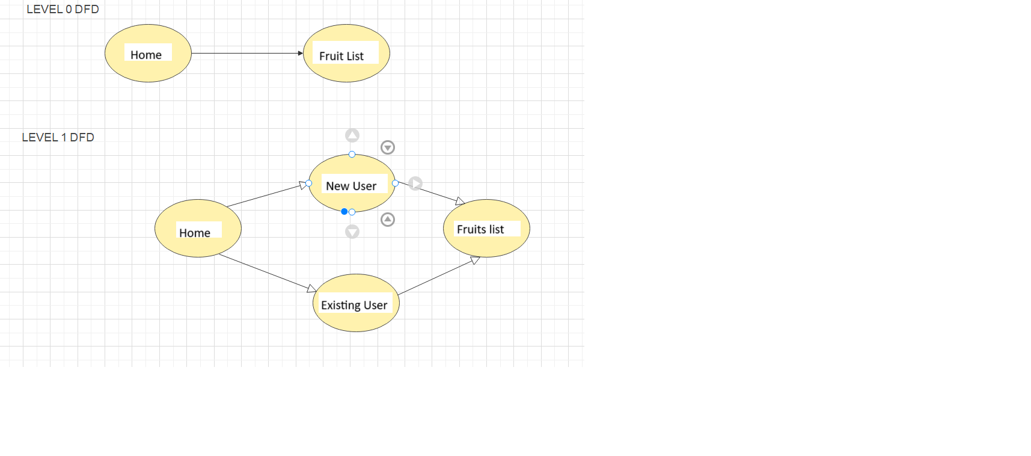
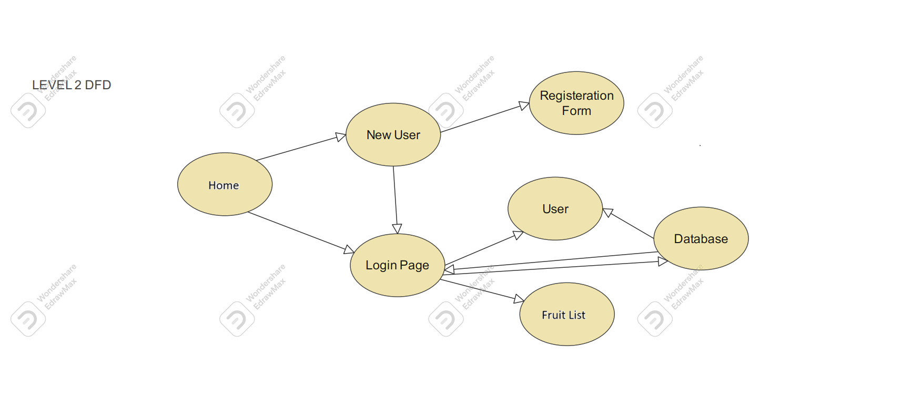
DATAFLOW DIAGRAM

Slide 12
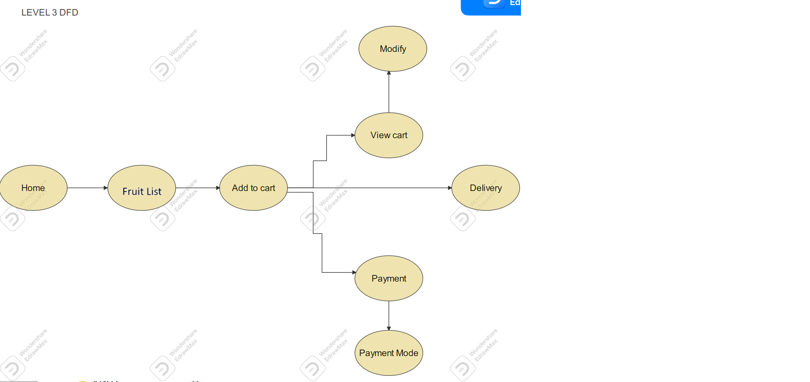

Slide 13
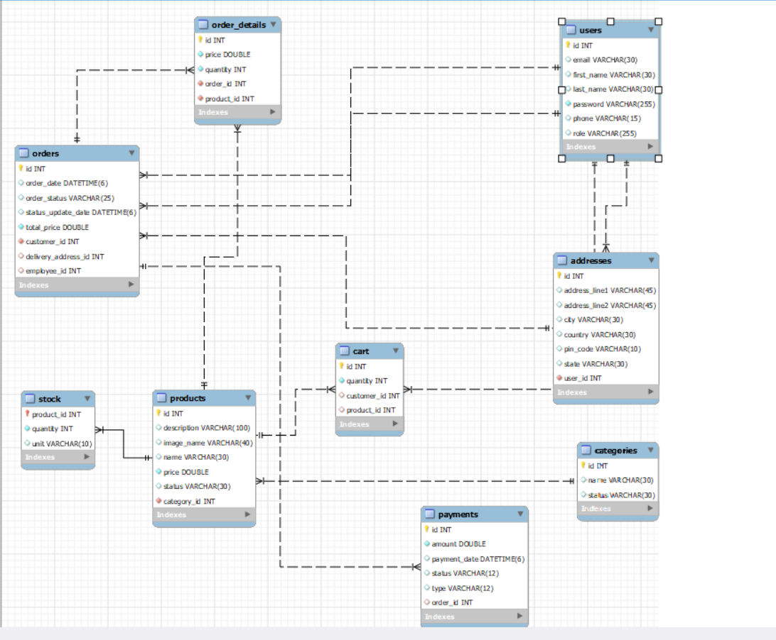
E-R diagram:

Slide 14
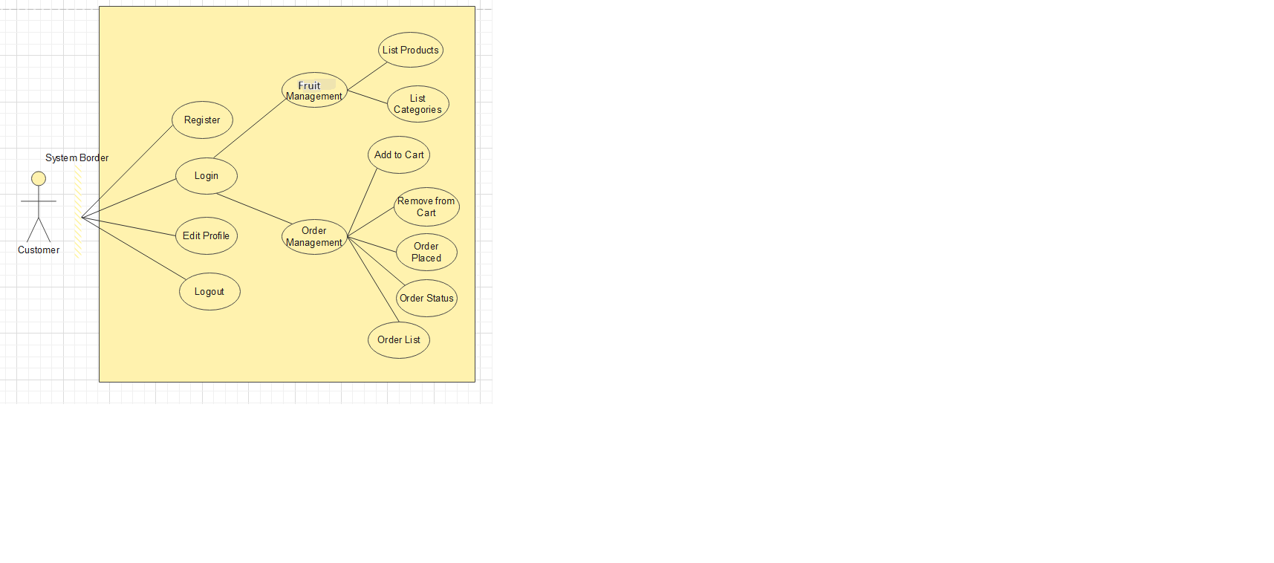
USE CASE DIAGRAM

Slide 15
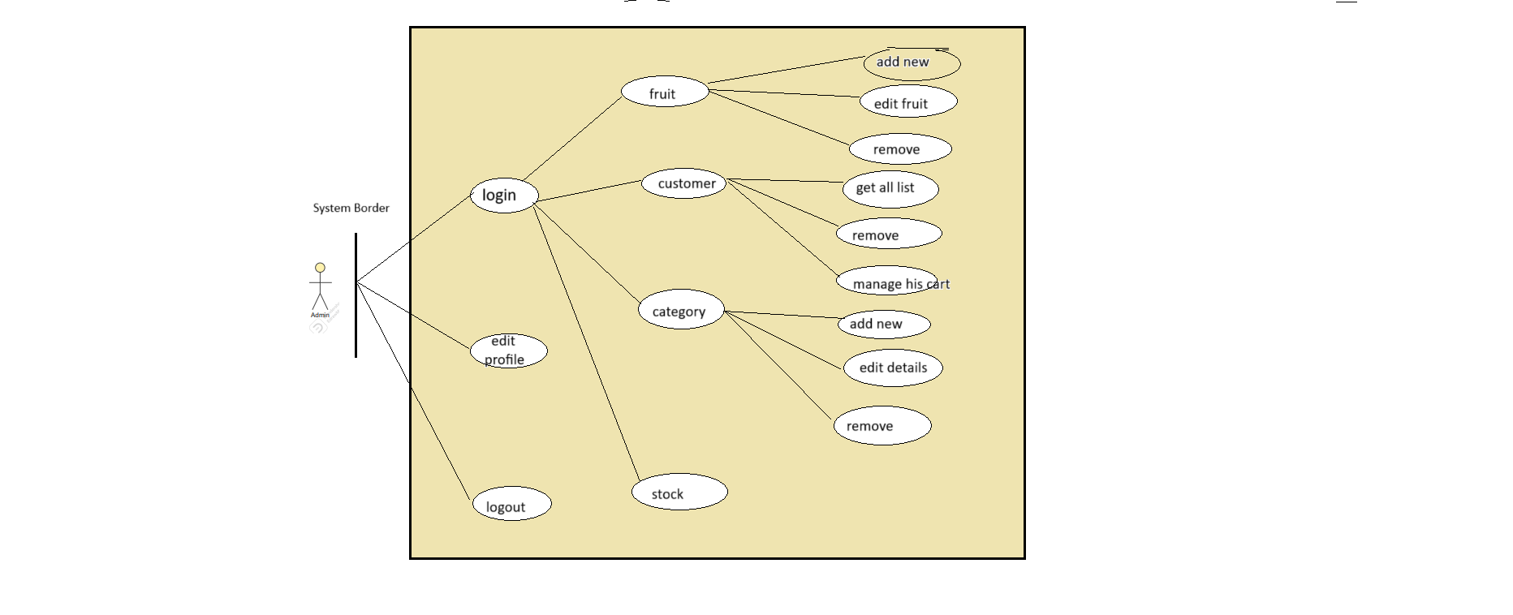

Slide 16
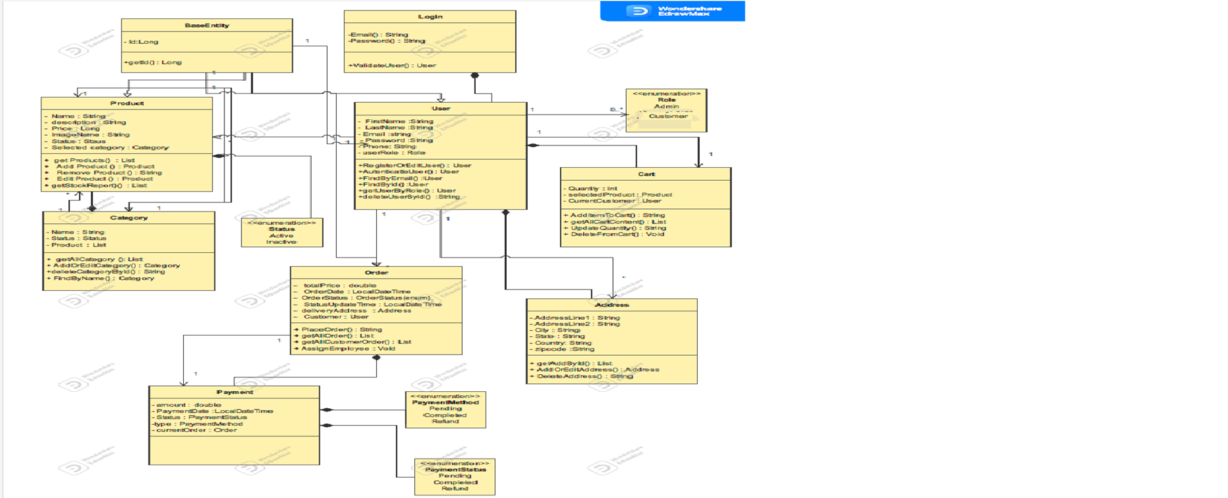
CLASS DIAGRAM

Slide 17
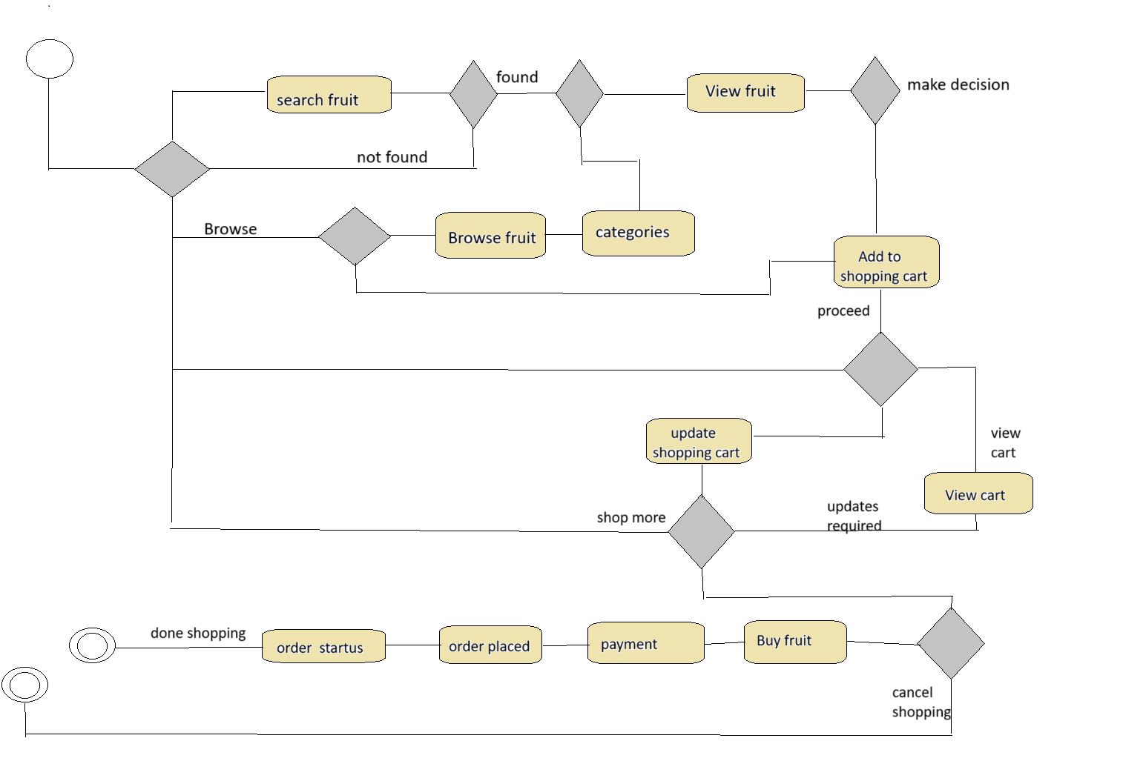
ACTIVITY DIAGRAM

Slide 18
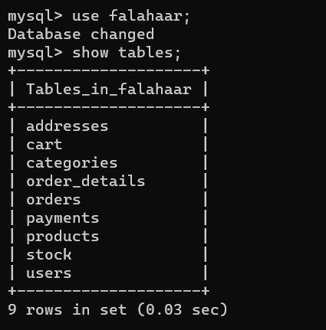
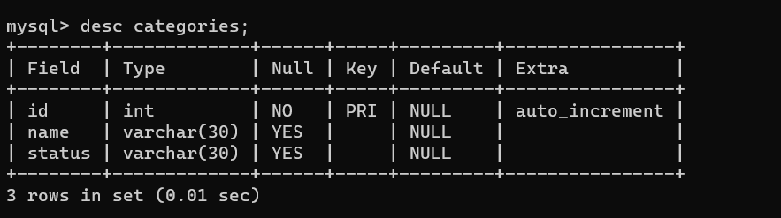
TABLES
1)List of Table:
2)Categories Table

Slide 19
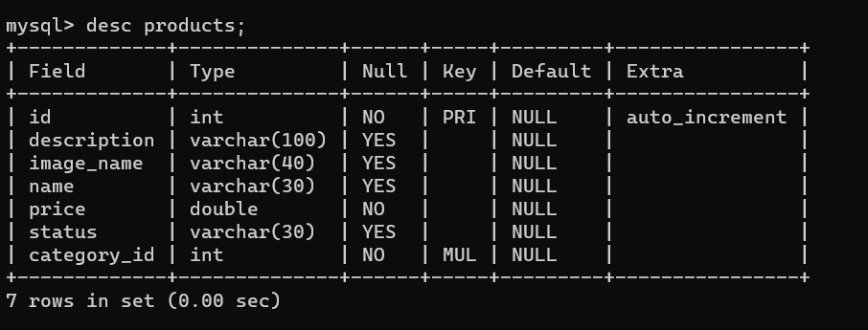
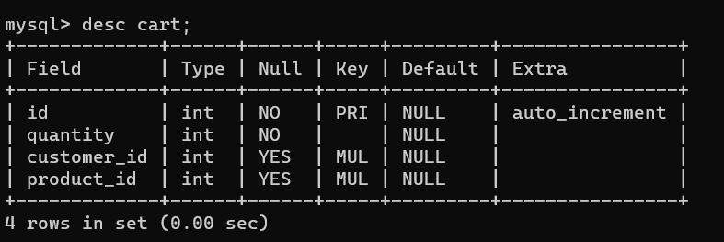
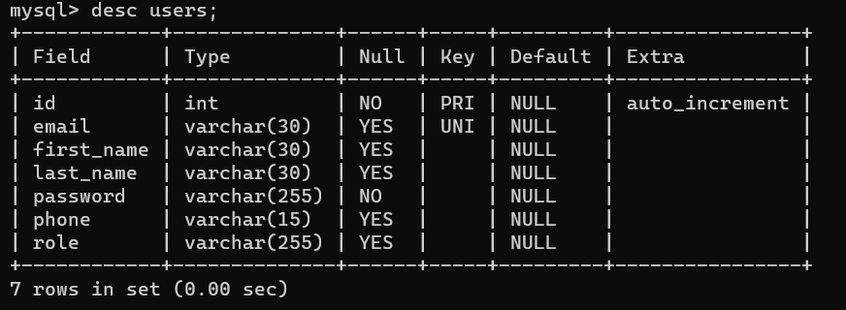
3)Products Table:
4)Cart Table:
5)Users Table:

Slide 20
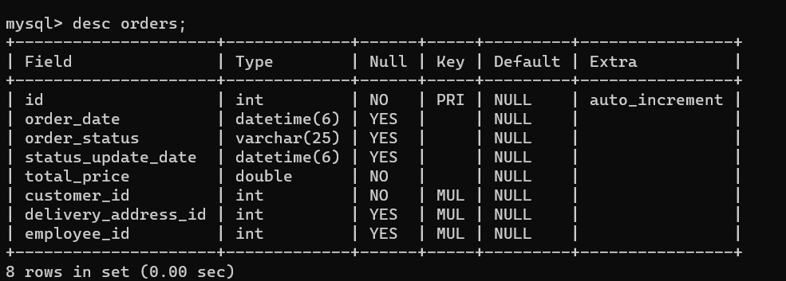
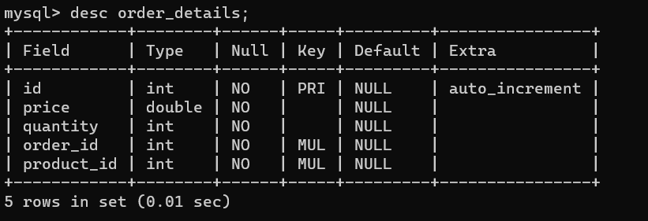
6) Orders Table:
7) Orders_details Table:

Slide 21
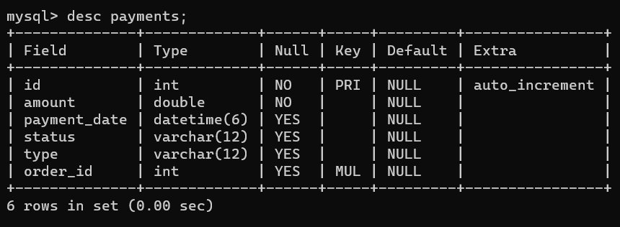
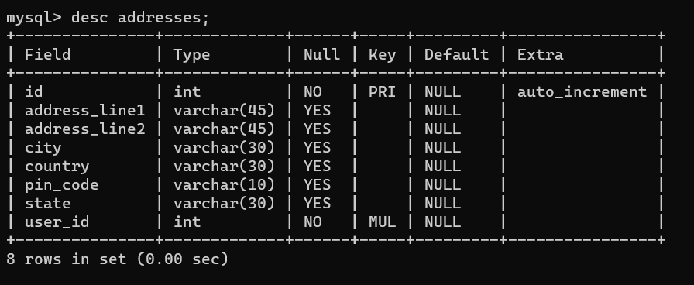
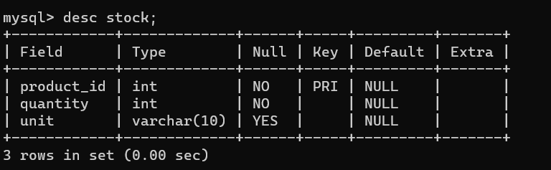
8) Payments Table:
9) Addresses Table:
10) Stock Table:

Slide 22
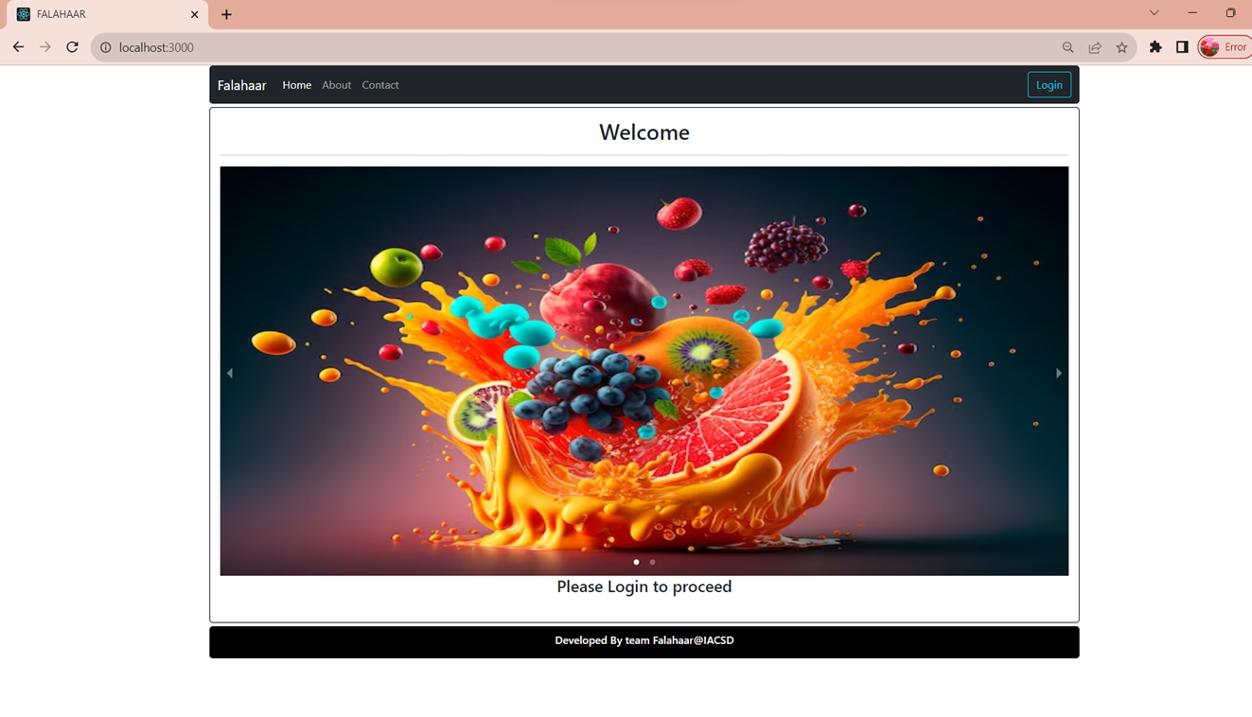
SCREENSHOTS

Slide 23
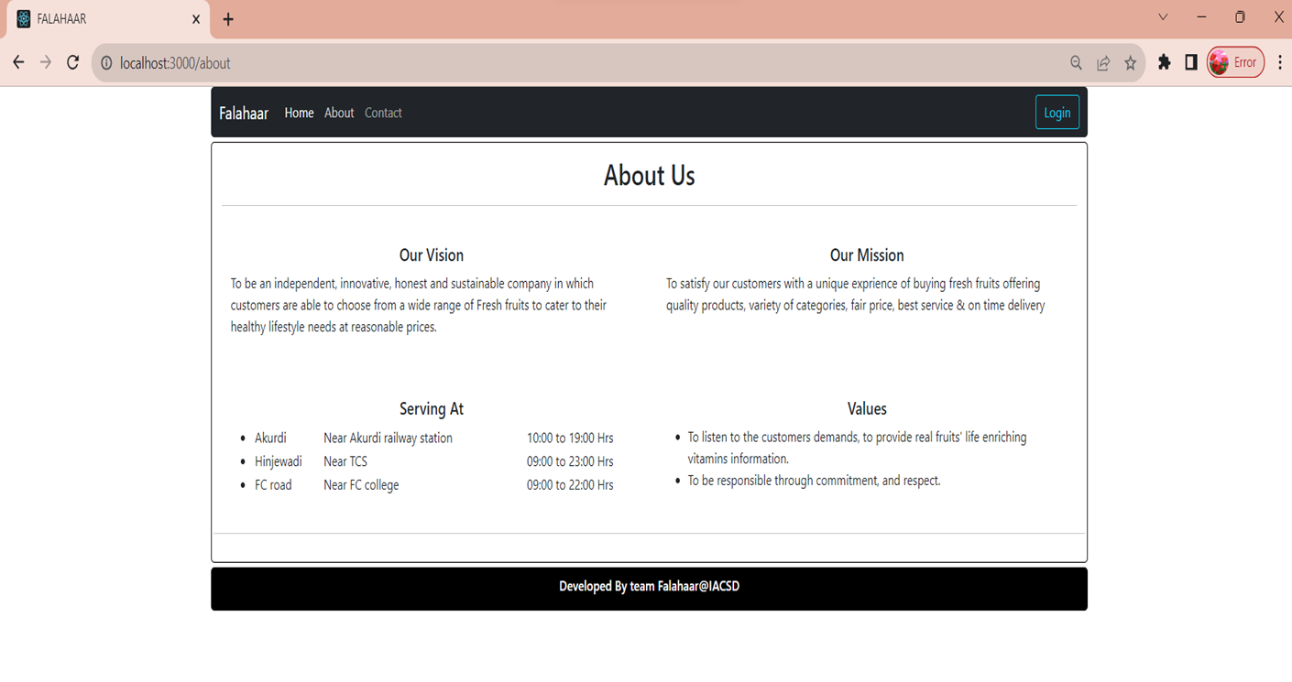

Slide 24
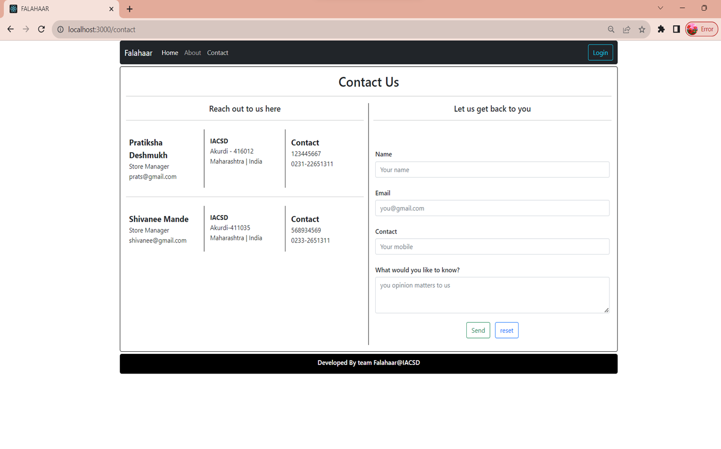

Slide 25
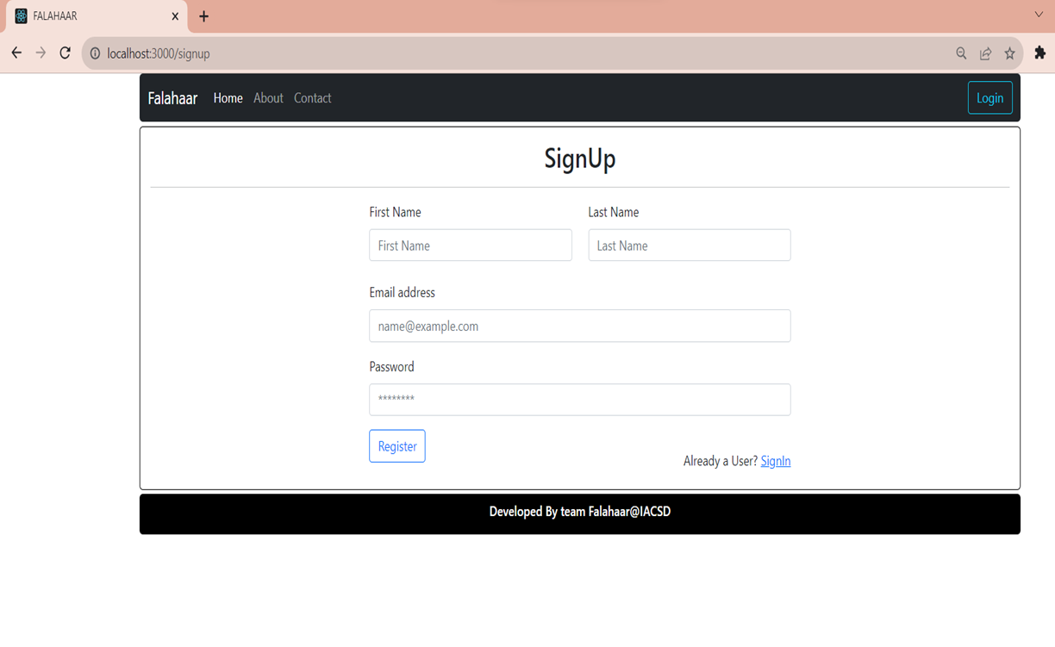

Slide 26
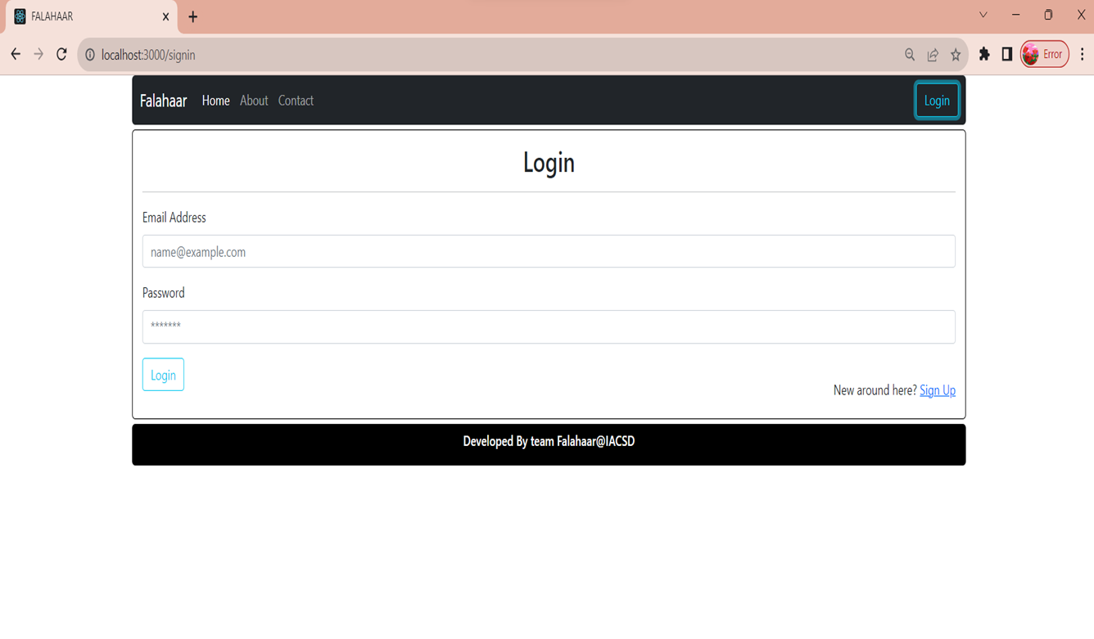

Slide 27
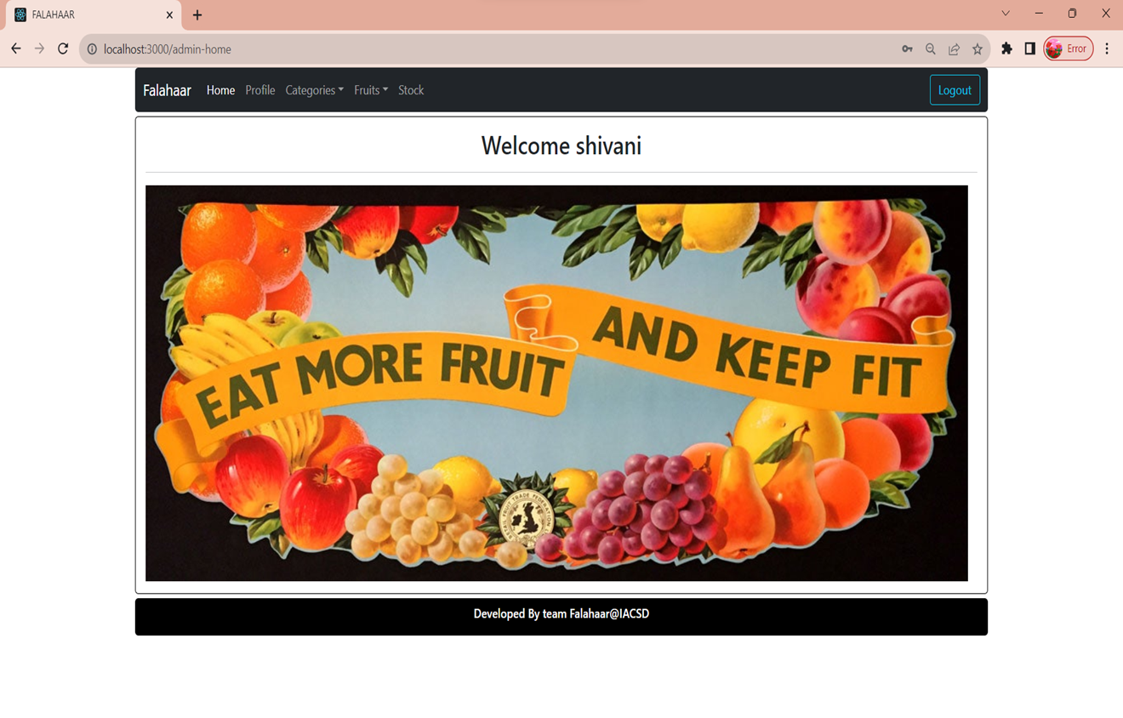

Slide 28
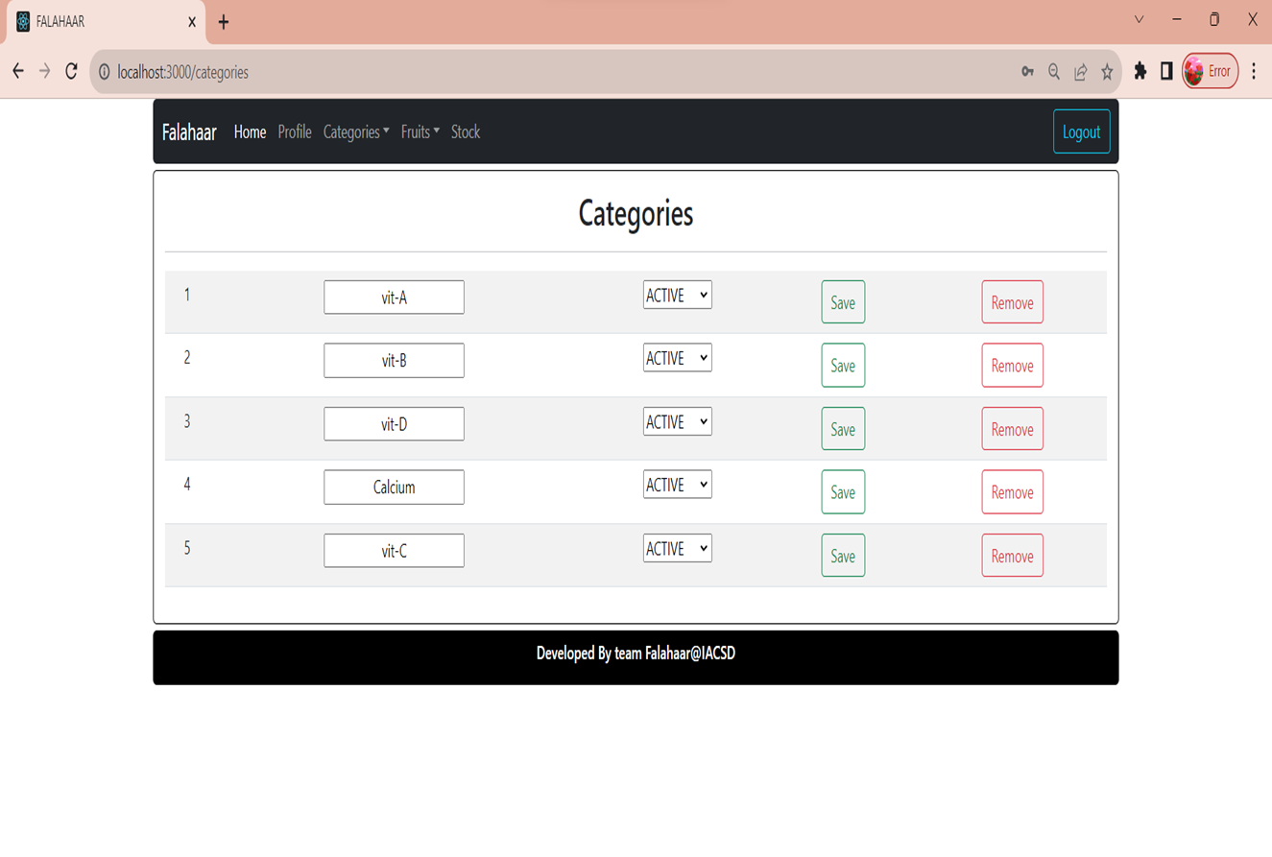

Slide 29
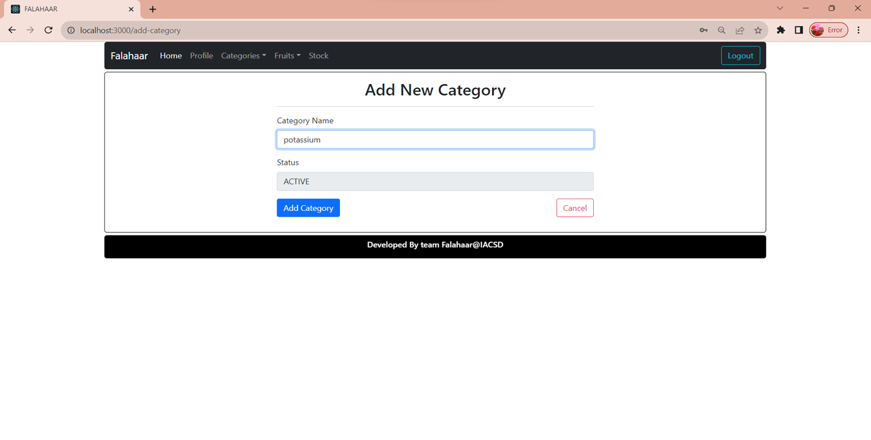

Slide 30
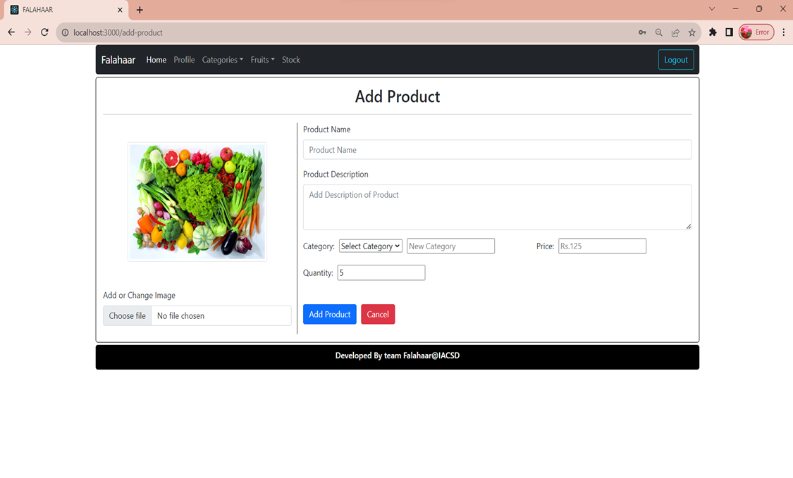

Slide 31
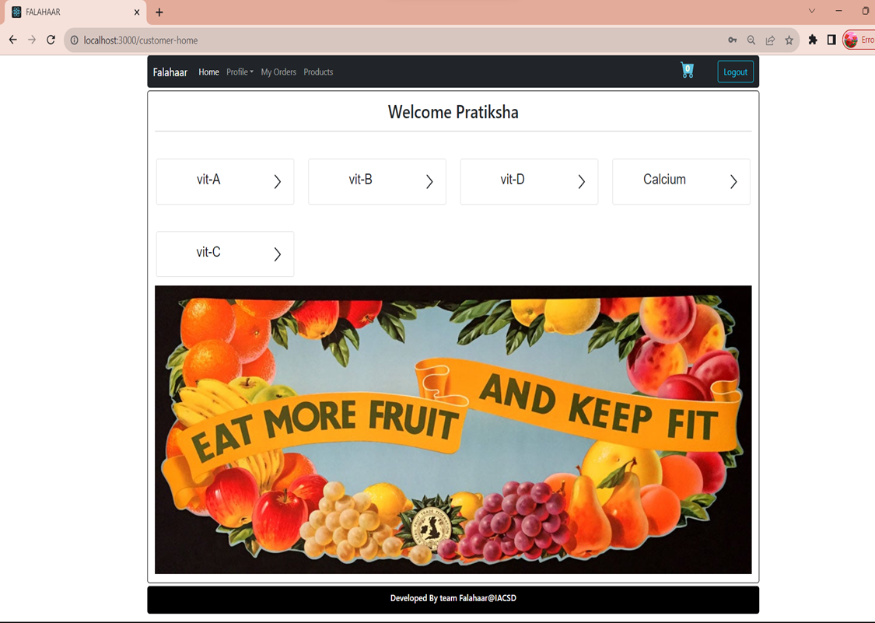

Slide 32
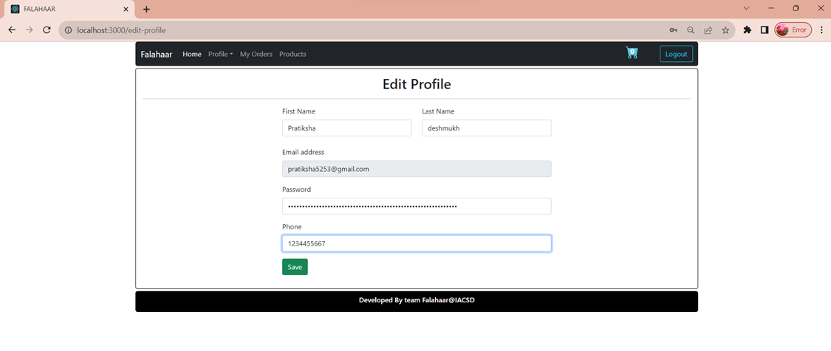

Slide 33
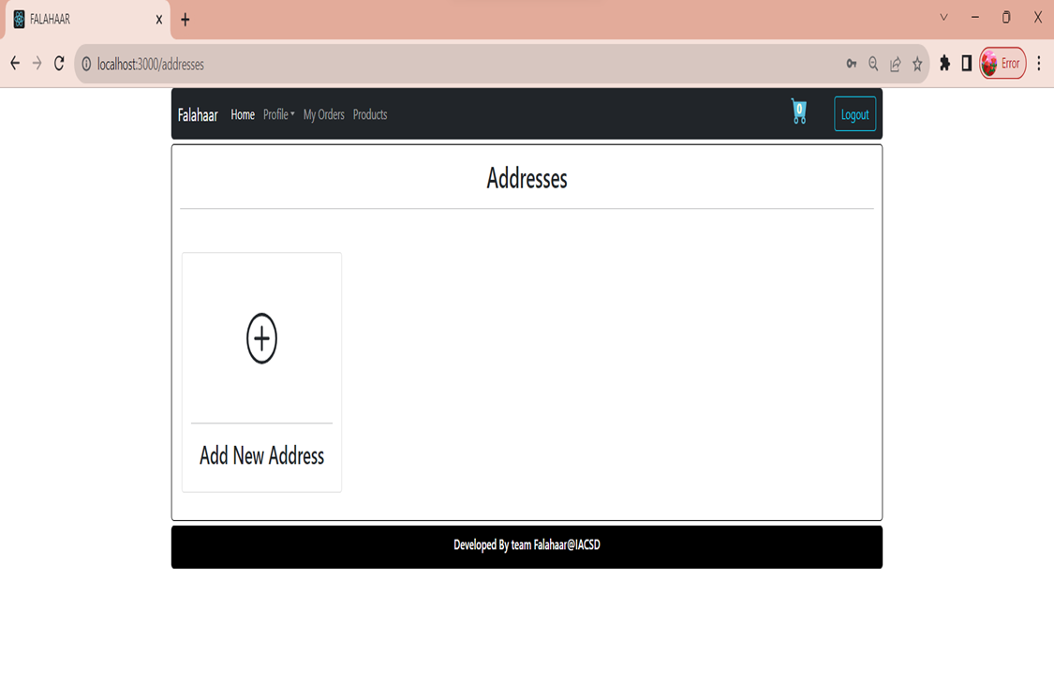

Slide 34
ADVANTAGES
Ability to handle multiple purchases .
Automation minimizes human error .
Lower costs of store maintenance .
You can retarget the customers .
Detailed product information .
Ecommerce save time for a customer

Slide 35
DISADVANTAGES
Compulsory registration .
Some items are hard to purchase online .
Waiting for a product to be delivered .
Security issue .

Slide 36
FUTURE SCOPE
There is a scope for further development in our project to a great extent. A number of features can be added to this system in future like providing moderator more control over products so that each moderator can maintain their own fruits.
Another feature we wished to implement was providing classes for customers so that different offers can be given to each class.
System may keep tracks of History of purchases of each customer and provide suggestions based on their history . These features could have implemented unless the time did not limit us.

Slide 37
CONCLUSION
This online fruit shop is committed to providing a convenient and delightful shopping experience for fruit enthusiasts everywhere.
Our user-friendly platform ensures effortless navigation and secure transactions, allowing you to browse, choose, and order your favorite fruits with ease.
However, the availability of online shopping has produced a more educated consumer that can shop around with relative ease without having to spend a large amount of time. In exchange, online shopping has opened up doors to many small retailers that would never be in business if they had to incur the high cost of owning a brick and mortar store.
At the end, it has been a win-win situation for both consumer and sellers.

Slide 38
REFRENCES
[1] JavaScript Enlightenment, Cody Lindley-First Edition, based on JavaScript 1.5, ECMA-262, Edition
[2] Mc Graw Hill’s, Java: The complete reference 7thEdition, Herbert Scheldt
[3] Complete CSS Guide, Maxine Sherrin and John Allsopp - O'Reilly Media; September 2012
ONLINE REFERENCE :
[1] www.Google.com
[2] www.w3school.com
[3] www.javatpoint.com

Slide 39
THANK YOU !!!

